Slide 1
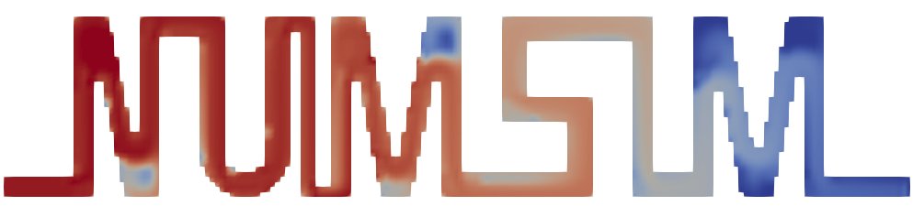

Institut for Parallel and Distributed Systems
Numerical Simulation
fluid solver for laminar flow with arbitrary geometries & heat flow
09.02.2021
[University of Stuttgart] [Stefania Scheurer, Marius Stach, Julian Franquinet]

Slide 2
Task and Implementation
Numerical Simulation

Slide 3
Heat Flow
Task
How to include temperature into code?
How to include temperature computation into solver?
What else to do?

Slide 4
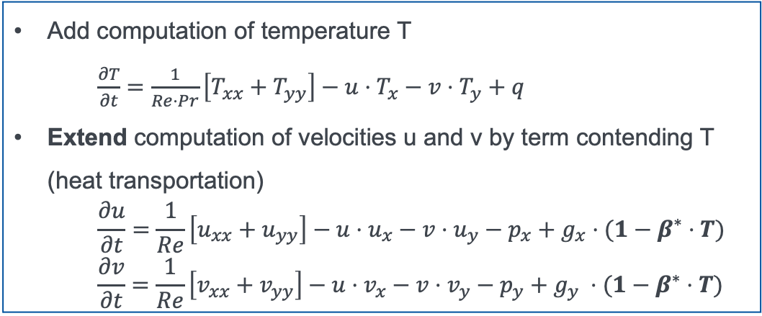
Heat Flow
Task
Add computation of temperature T
$\frac{∂T}{∂t}=\frac{1}{Re⋅Pr}\left[T_{xx}+T_{yy}\right]−u⋅T_{x}−v⋅T_{y}+q$
Extend computation of velocities u and v by term contending T (heat transportation)
$$\frac{∂u}{∂t}=\frac{1}{Re}\left[u_{xx}+u_{yy}\right]−u⋅u_{x}−v⋅u_{y}−p_{x}+g_{x}⋅(1−β^{∗}⋅T)$$
$$\frac{∂v}{∂t}=\frac{1}{Re}\left[v_{xx}+v_{yy}\right]−u⋅v_{x}−v⋅v_{y}−p_{y}+g_{y} ⋅(1−β^{∗}⋅T)$$
How to include temperature into code?
How to include temperature computation into solver?
What else to do?

Slide 5
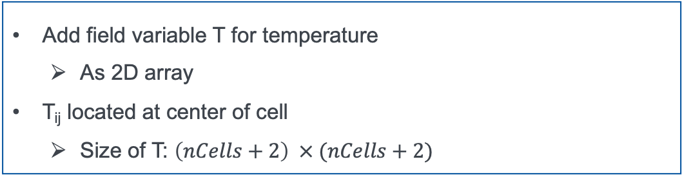
Heat Flow
Task
How to include temperature into code?
Add field variable T for temperature
As 2D array
T_{ij} located at center of cell
Size of T: $\left(nCells+2\right) × (nCells+2)$
How to include temperature computation into solver?
What else to do?

Slide 6
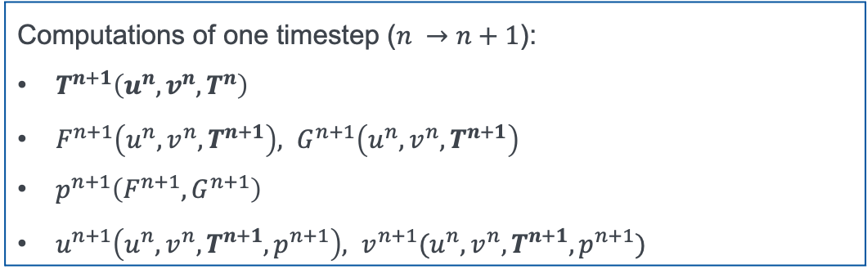
Heat Flow
Task
How to include temperature into code?
How to include temperature computation into solver?
Computations of one timestep ($n →n+1$):
$T^{n+1}\left(u^{n}, v^{n}, T^{n}\right)$
$F^{n+1}\left(u^{n}, v^{n}, T^{n+1}\right),$ $G^{n+1}\left(u^{n}, v^{n}, T^{n+1}\right)$
$p^{n+1}\left(F^{n+1}, G^{n+1}\right)$
$u^{n+1}\left(u^{n}, v^{n}, T^{n+1}, p^{n+1}\right),$ $v^{n+1}(u^{n}, v^{n}, T^{n+1}, p^{n+1})$
What else to do?

Slide 7
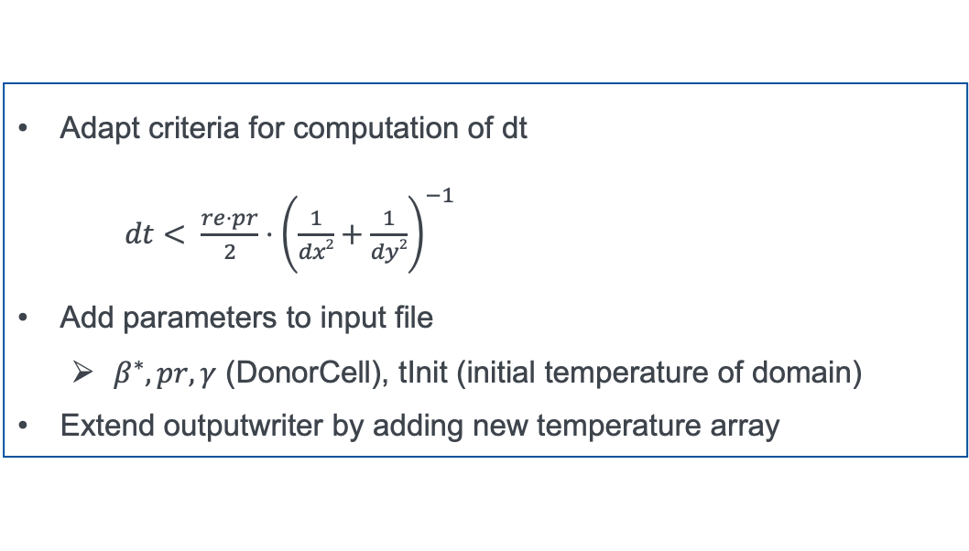
Heat Flow
Task
How to include temperature into code?
How to include temperature computation into solver?
What else to do?
Adapt criteria for computation of dt
$dt< \frac{re⋅pr}{2}⋅{\left.\left(\frac{1}{dx2}+\frac{1}{dy2}\right.\right)}^{−1}$
Add parameters to input file
$β^{∗}, pr, γ$ (DonorCell), tInit (initial temperature of domain)
Extend outputwriter by adding new temperature array

Slide 8
Arbitrary Geometries and Obstacles
Underlying concept: flag matrix
How to include “real” boundary conditions?
How to apply boundary conditions at obstacles?
How to include temperature?
What else to do?

Slide 9
Arbitrary Geometries and Obstacles
Underlying concept: flag matrix
Every cell assigned to type: FLUID, OBJECT, EMPTY
Computation only for celltype FLUID
Application of boundary conditions for celltype OBJECT:
only NOSLIP boundary conditions for obstacles/objects
Skip for celltype EMPTY
How to include “real” boundary conditions?
How to apply boundary conditions at obstacles?
How to include temperature?
What else to do?

Slide 10
Arbitrary Geometries and Obstacles
Underlying concept: flag matrix
How to include “real” boundary conditions?
1D arrays for each boundary (bottom, top, left, right)
One array each for boundary condition type and value
1D array conceivable as mix of INFLOW, OUTFLOW, NOSLIP
How to apply boundary conditions at obstacles?
How to include temperature?
What else to do?

Slide 11
Arbitrary Geometries and Obstacles
Underlying concept: flag matrix
How to include “real” boundary conditions?
How to apply boundary conditions at obstacles?
Only NOSLIP, but different computation depending on FLUID surroundings of OBJECT cell
OBJECT subdivided into types:
-LEFT, -RIGHT, -TOP, -BOTTOM;
-TOPLEFT, -TOPRIGHT, -BOTTOMLEFT, -BOTTOMRIGHT
How to include temperature?
What else to do?

Slide 12
Arbitrary Geometries and Obstacles
Underlying concept: flag matrix
How to include “real” boundary conditions?
How to apply boundary conditions at obstacles?
How to include temperature?
Objects can be heated or isolated
Two additional matrices for temperature boundary condition type (heated or isolated) and value (if heated)
Temperature at “real“ boundaries: extend 1D arrays by boundary type and value
What else to do?

Slide 13
Arbitrary Geometries and Obstacles
Underlying concept: flag matrix
How to include “real” boundary conditions?
How to apply boundary conditions at obstacles?
How to include temperature?
What else to do?
Outputwriter uses staggered grid to write .vts files
EMPTY cells are blanked
How to create the input .txt file for boundaries and obstacles?

Slide 14
Input File for Boundaries and Obstacles
Numerical Simulation

Slide 15
How to define boundary condtion types and values?
Input File: Example
{
Type= Bottombound
Velocity= Dirichlet; 0; 0
Pressure= Neumann; 0
Temperature= Neumann; 0
Position = 0; 1
}
location of boundary
boundary type& values (u;v)
boundary type and value (p)
boundary type and value (T)
physical starting and end value

Slide 16
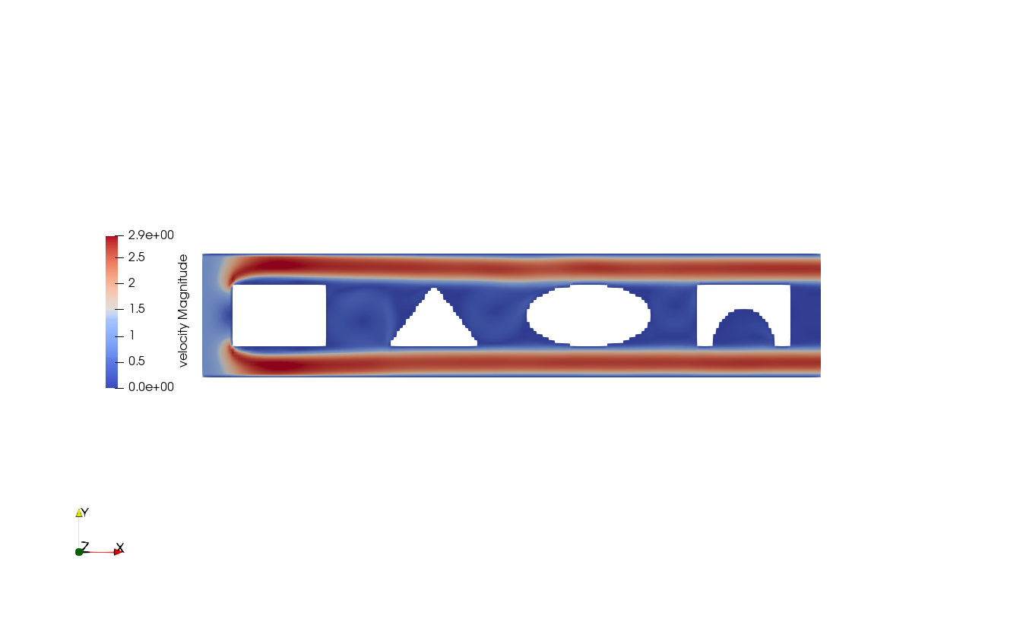
How to define obstacles?
Input File: Example
{
Shape = Rectangle
Position = 0; 0; 1; 1
Temperature = Dirichlet; 1
}
Shape of obstacle
Lower left and upper right corner
Temperature type and value
{
Shape = Ellipse
Position = 1; 1; 0.8; 0.5
Temperature = Neumann; 0
}
Shape of obstacle
Center and halfaxes
Temperature type and value
{
Shape = Triangle
Position = 0; 0; 0; 1; 0.5; 1
Temperature = Dirichlet; 5
Type = Fluid
}
Shape of obstacle
Corners of triangle
Temperature type and value
Fluid type to cut out shape of obstacle

Slide 17
Examples
Numerical Simulation

Slide 18
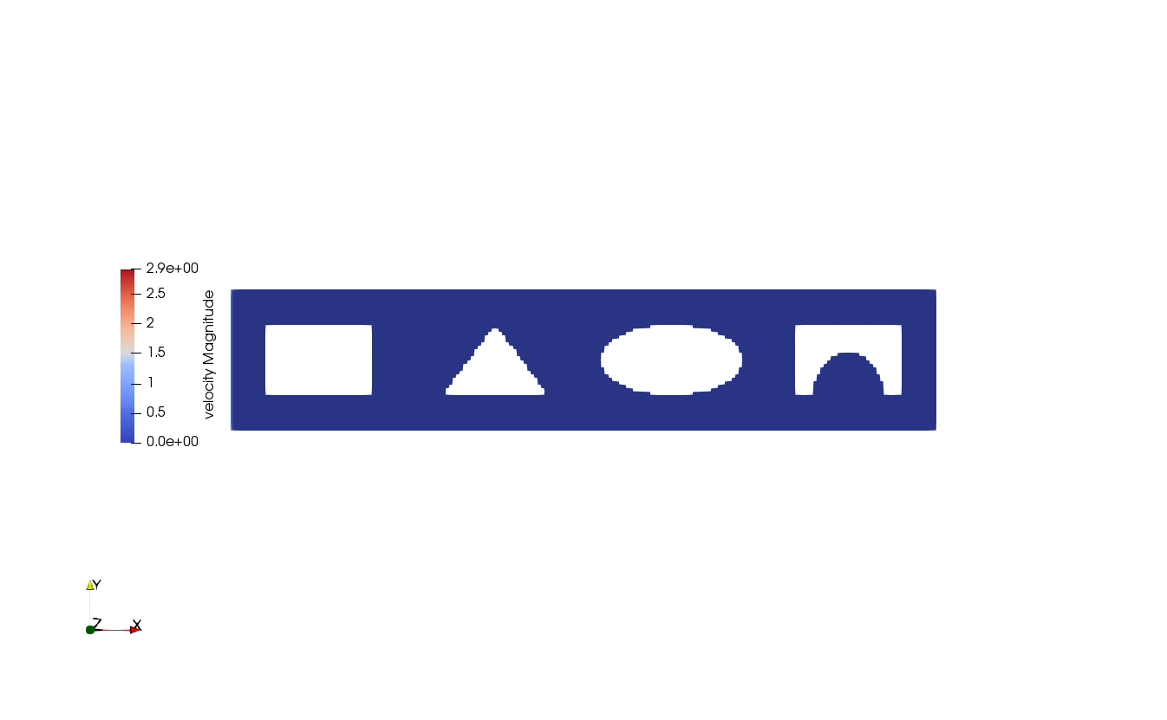
Standard Forms: Possible Obstacles
Settings
physSize: 10x2
nCells: 200x40
endTime: 15s

Slide 19
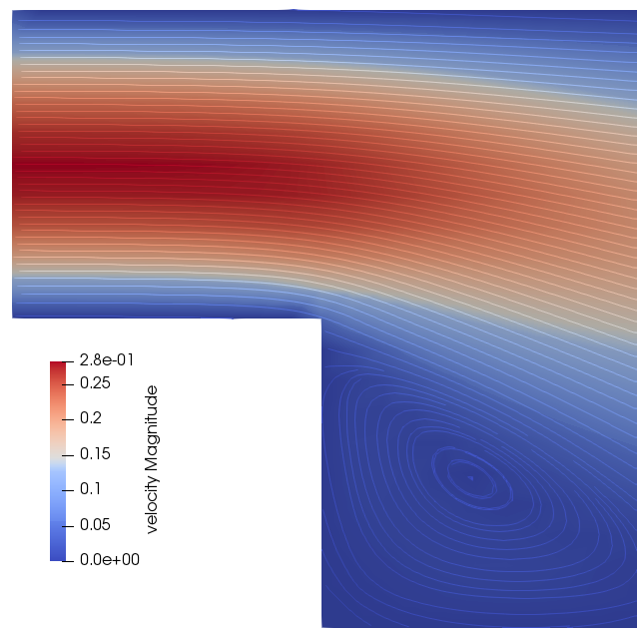
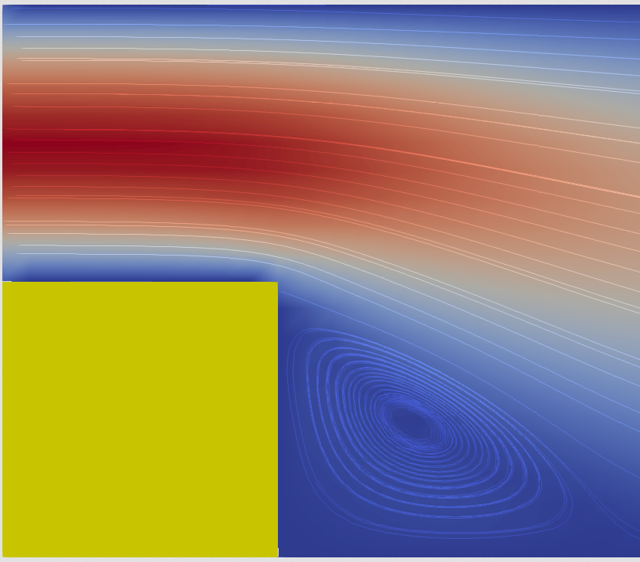
Channel with a Step: Comparison for Obstacles
Settings
physSize: 10x2
nCells: 100x20
endTime: 500s
Our Solver
Other Solver

Slide 20
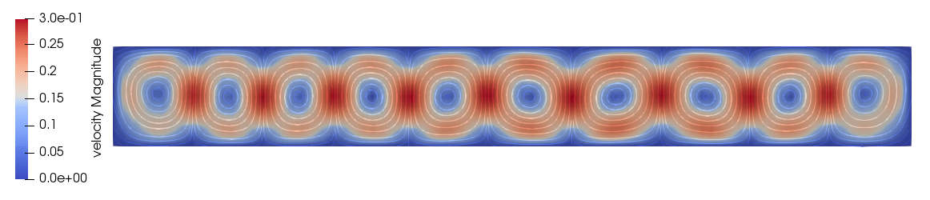
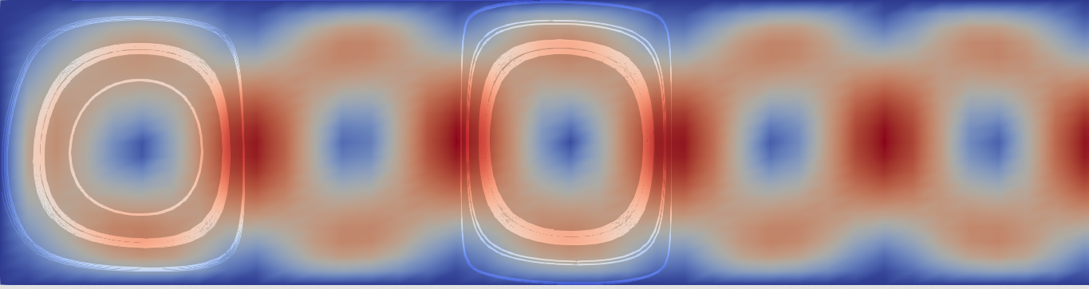
Rayleigh-Benard: Comparison for Heat Flow
Our Solver
Other Solver
Settings
physSize: 8x1
nCells: 80x20
endTime: 100s

Slide 21
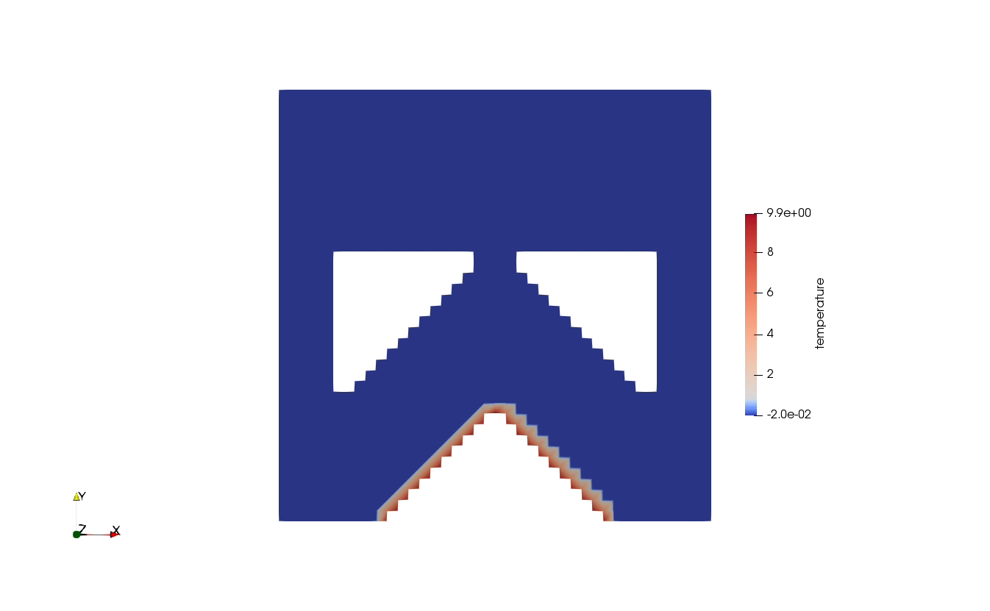
Fountain: Combination of Obstacles and Heat Flow
Settings
physSize: 2x2
nCells: 40x40
endTime: 20s

Slide 22
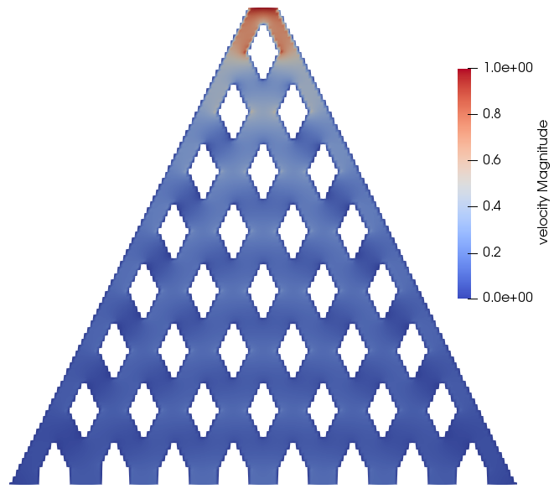
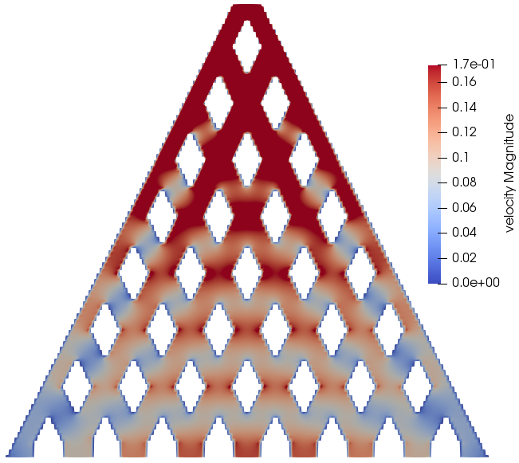
Beanmachine
Settings
physSize: 34x32
nCells: 170x160
endTime: 0.05s

Slide 23
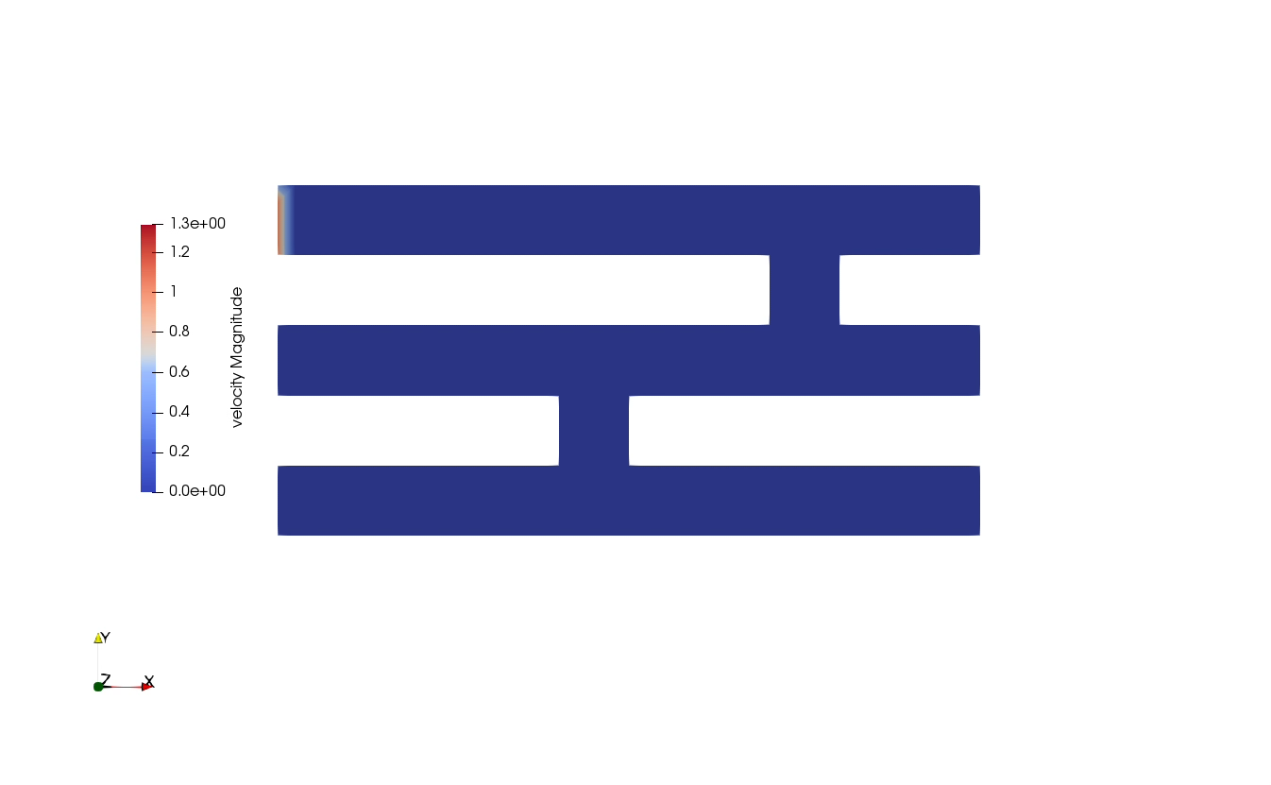
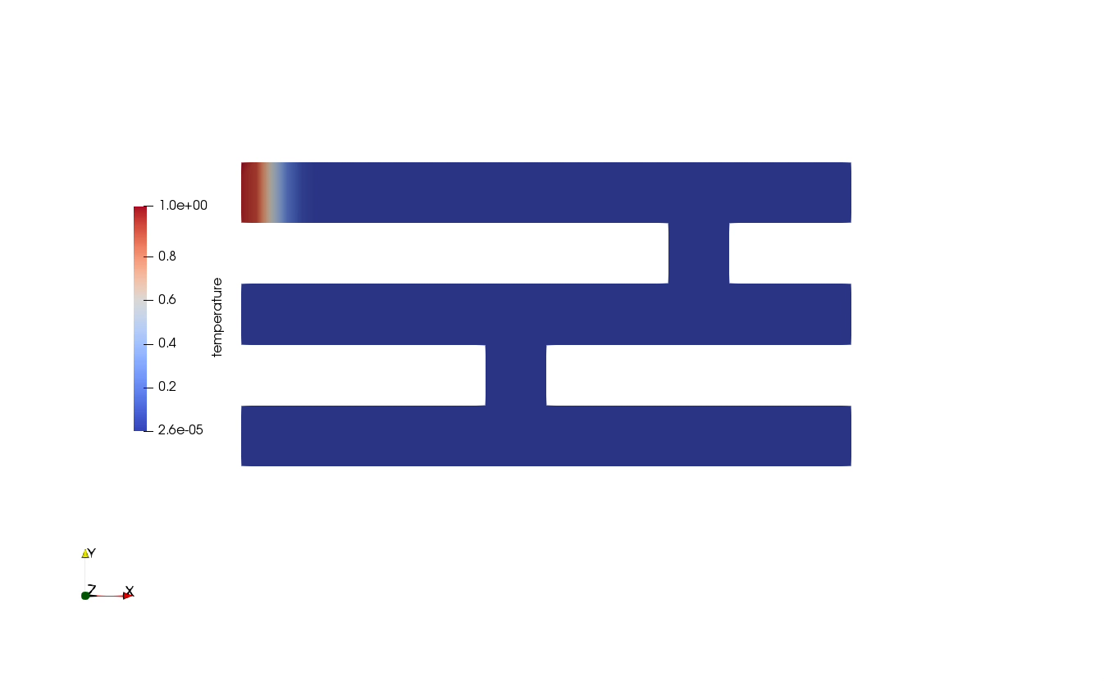
Labyrinth
Velocity
Settings
physSize: 5x2
nCells: 40x20
endTime: 50s
Temperature

Slide 24
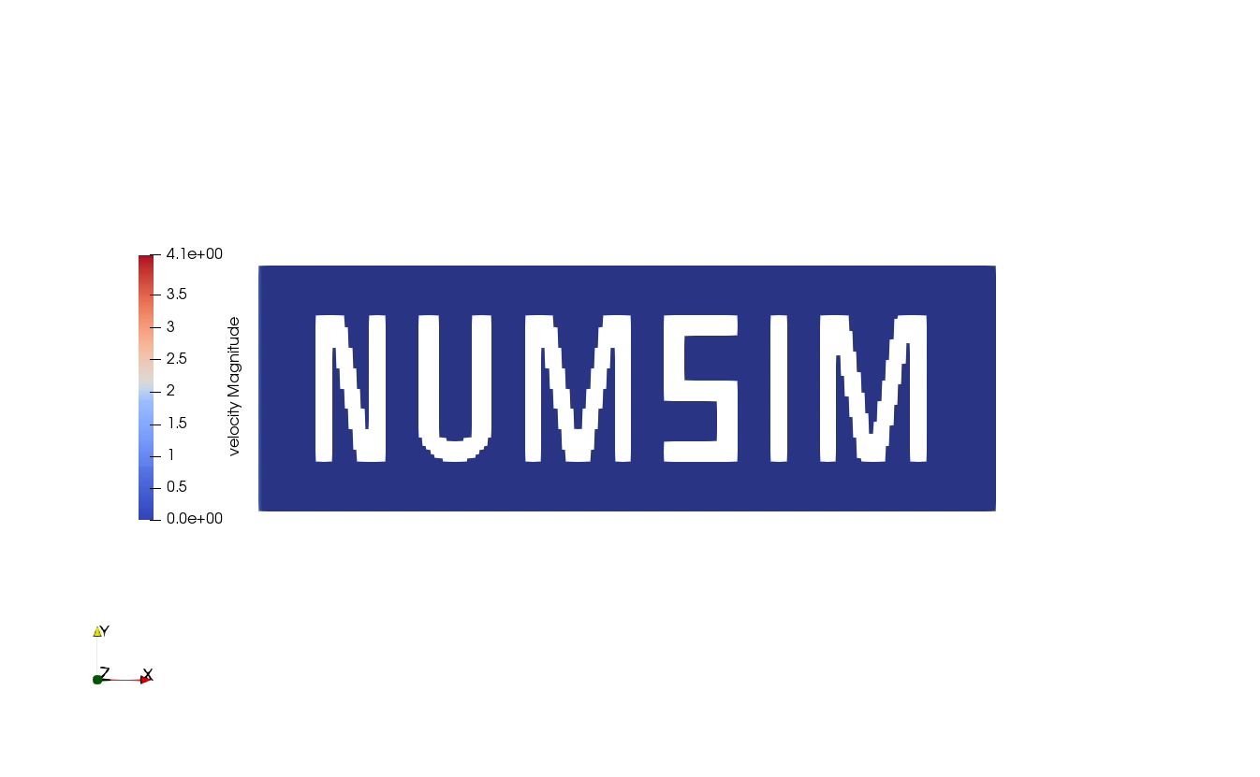
NumSim
Settings
physSize: 15x5
nCells: 180x60
endTime: 20s

Slide 25


NumSim Flow
Settings
physSize: 15x5
nCells: 180x60
endTime: 20s
Velocity
Temperature

Slide 26
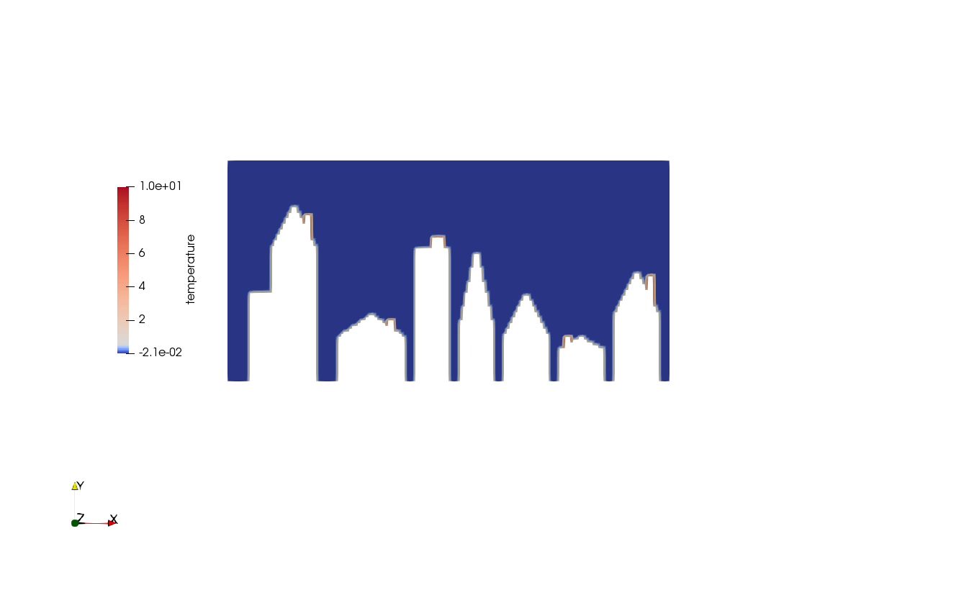
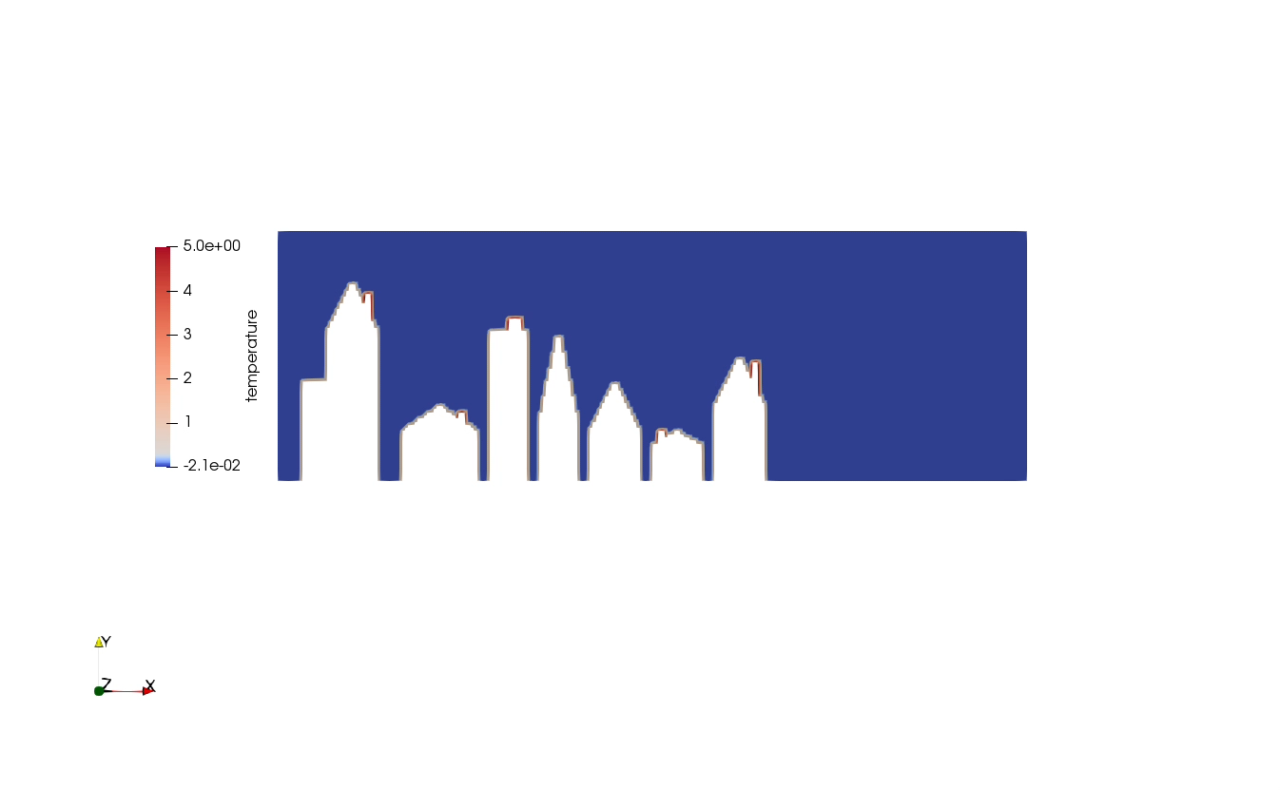
City
Settings
physSize: 10x5, 15x5
nCells: 160x80, 240x80
endTime: 10s

Slide 27
Institut for Parallel and Distributed Systems
Stefania Scheurer, Marius Stach, Julian Franquinet
e-mail
enter address
phone +49 (0) 711 685-
www.
enter address
University of Stuttgart

